Slide 1
Graphs

Slide 2
Graphs: Logical Level
A graph is a set of vertices (nodes) and a set of edges that relate the vertices to each other
Each vertex is a “thing” or data point, such as a person or a city
Edges are represented as pairs of vertices
Graphs are somewhat similar to binary trees, but have no restrictions on the connections between nodes

Slide 3
Edge Direction
Directed Graph: Each edge is directed from one vertex to the other vertex
For example, on a graph of cities, a directed edge from Houston to Austin could represent a flight
Undirected Graph: Edges have no direction
For example, on a graph of cities, an undirected edge from Houston to Austin could represent a road

Slide 4
Formal Definition
Graphs are based on the mathematical concept
A graph G is defined as G = (V,E)
V is a finite, nonempty set of vertices
E is a set of edges (written as pairs of vertices)

Slide 5
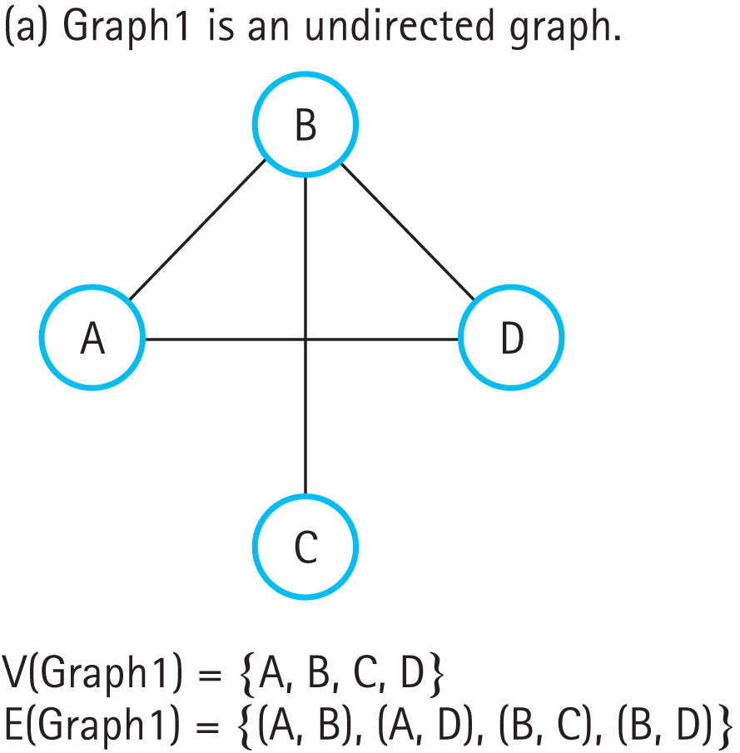
Graph Examples
Figure 13.1a Some examples of graphs (a) Graph1 is an undirected graph
(b) Graph2 is a directed graph (c) Graph3 is a directed graph

Slide 6
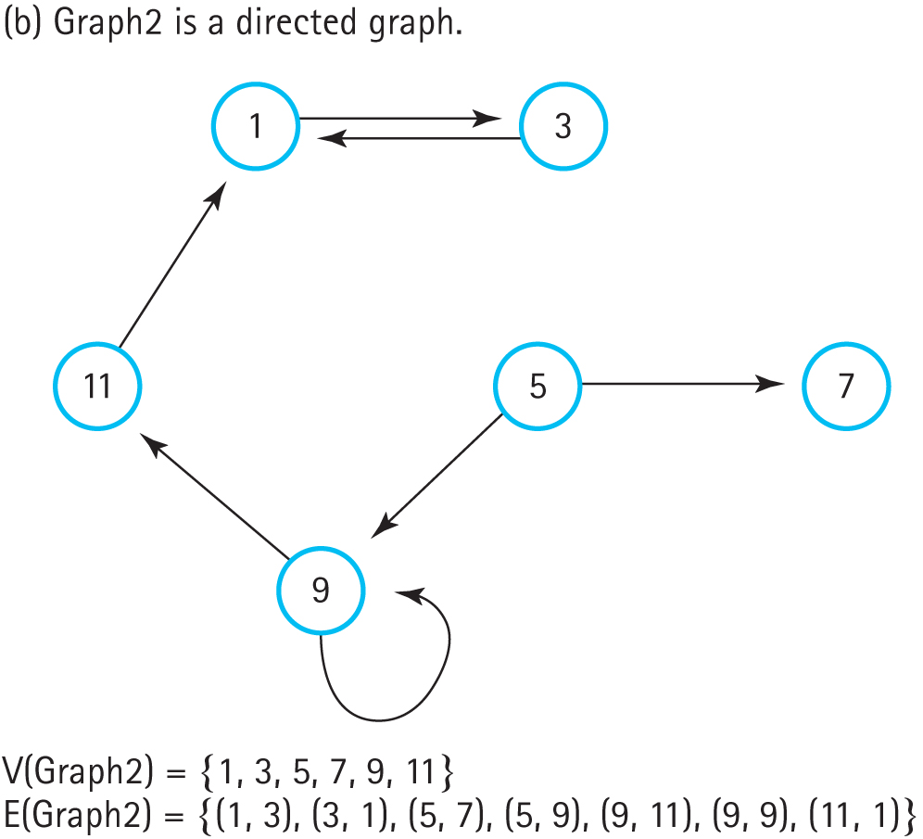
Graph Examples (cont.)
Figure 13.1b Some examples of graphs (a) Graph1 is an undirected graph
(b) Graph2 is a directed graph (c) Graph3 is a directed graph

Slide 7
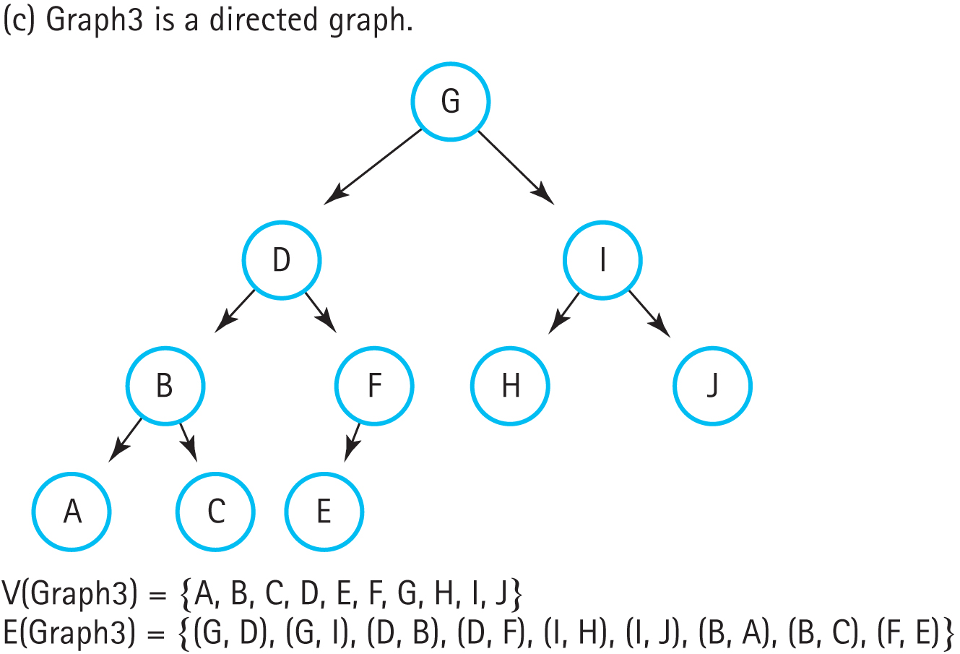
Graph Examples (cont.)
This graph is a tree, which is a special case of a directed graph
Figure 13.1c Some examples of graphs (a) Graph1 is an undirected graph
(b) Graph2 is a directed graph (c) Graph3 is a directed graph

Slide 8
Adjacency
Two vertices are said to be adjacent if they are connected by an edge
If they’re connected by a directed edge:
The first vertex is adjacent to the second vertex
The second vertex is adjacent from the first vertex
A path is a sequence of vertices that connects two vertices in the graph

Slide 9
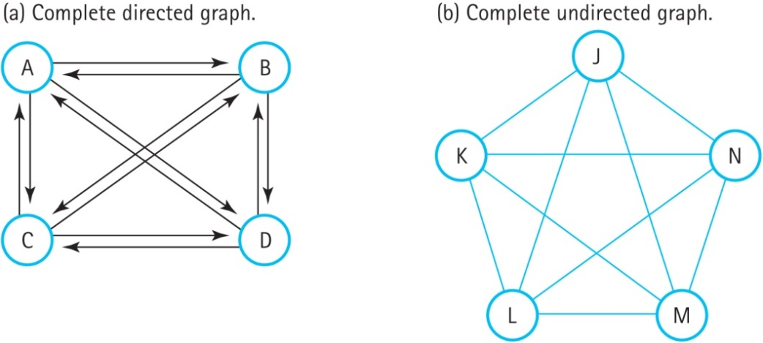
Completeness
In a complete graph, every node is directly connected to every other node
A complete directed graph with N nodes has
N*(N-1) edges
A complete undirected graph with N nodes has N*(N-1)/2 edges
Figure 13.2 Two complete graphs (a) Complete directed graph (b) Complete
undirected graph

Slide 10
Weighted Graph
In a weighted graph, each edge has an associated value
A weight typically represents the cost of moving between the two vertices
For instance, the weights on a graph of cities would be the distance between the cities
The total distance between two cities is the sum of weights on the path between them

Slide 11
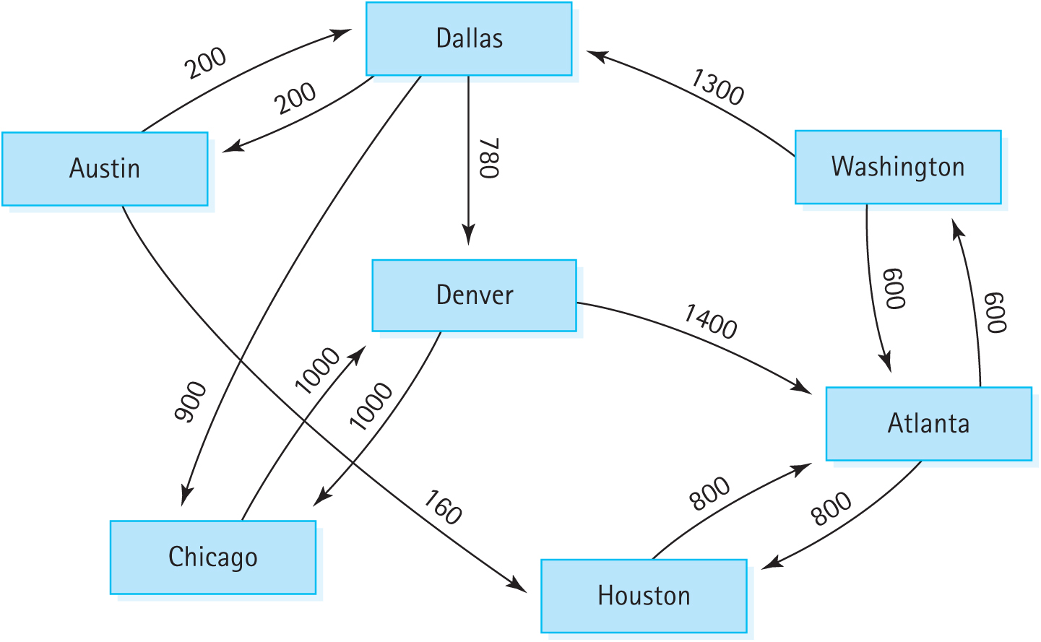
Weighted City Graph
Figure 13.3 A weighted graph

Slide 12
Graph Operations
Transformers: AddVertex, AddEdge, and MakeEmpty
Observers: IsFull, IsEmpty, GetWeight, GetToVertices (returns a queue of adjacent vertices)
Many other graph operations are possible, but these ones are all we need for now

Slide 13
Graphs: Application Level
Graph traversal is a commonly used operation
Like trees, there are multiple ways to do it
Because traversing the graph is independent of the graph itself, the graph traversal methods are separate from the graph operations

Slide 14
Depth-First Search
Depth-first search follows a path as far as possible before backtracking
It is useful in graphs for checking if a path exists between two nodes
https://www.youtube.com/watch?v=zaBhtODEL0w
https://www.youtube.com/watch?v=QRq6p9s8NVg&t=34s

Slide 15
DFS Algorithm
Add the nodes adjacent to the start node to the stack
Pop a node off the stack and examine it
Add all of the nodes adjacent to the popped node to the stack
Continue until the target node is found or the stack is empty (no more nodes to check)

Slide 16
DFS Example
We’ll use the airport map for an example
Figure 13.3 A weighted graph

Slide 17
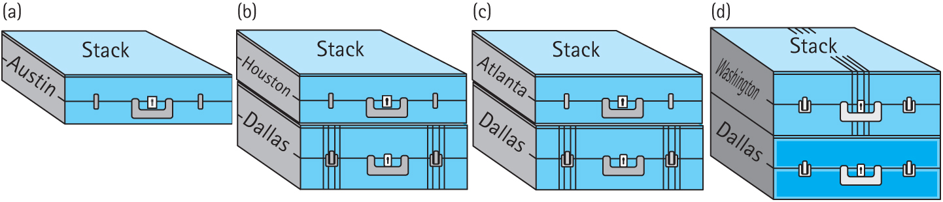
DFS Example (cont.)
Flying from Austin to Washington
Push Austin onto the stack
Pop Austin, push Dallas and Houston onto the stack
Pop Houston, push Atlanta
Pop Atlanta, push Washington and Houston
Figure 13.4 Using a stack to store the routes

Slide 18
Marking
Atlanta leads to both Houston and Washington, but we already visited Houston
By marking nodes, DFS can avoid revisiting nodes, which would lead to cycles
Three new operations: MarkVertex transformer, IsMarked observer, and ClearMarks (clears marks from all nodes)
Marked nodes are not added to the stack

Slide 19
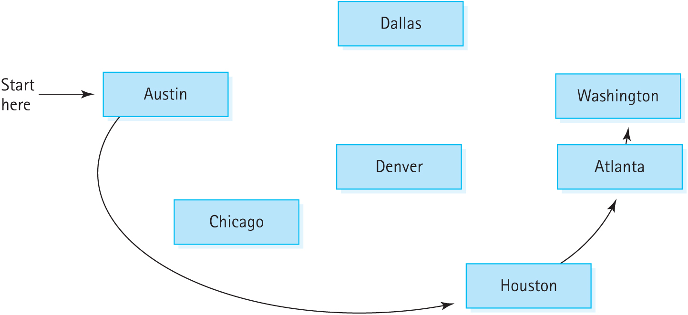
DFS Example
Figure 13.5 The depth-first search

Slide 20
Breadth-First Search
Breadth-first search examines all possible paths of the same length before going further
DFS backtracks as little as possible, while BFS backtracks as far as possible
In a binary tree, BFS would explore all the nodes at a particular level before exploring any nodes on the next level
BFS uses a queue to keep track of nodes

Slide 21
BFS Example
Enqueue Dallas and Houston
Dequeue Dallas, enqueue Chicago and Denver
Dequeue Houston, enqueue Atlanta
Continue until Washington is dequeued
BFS explored all of the one-flight paths before checking the two-flight paths

Slide 22
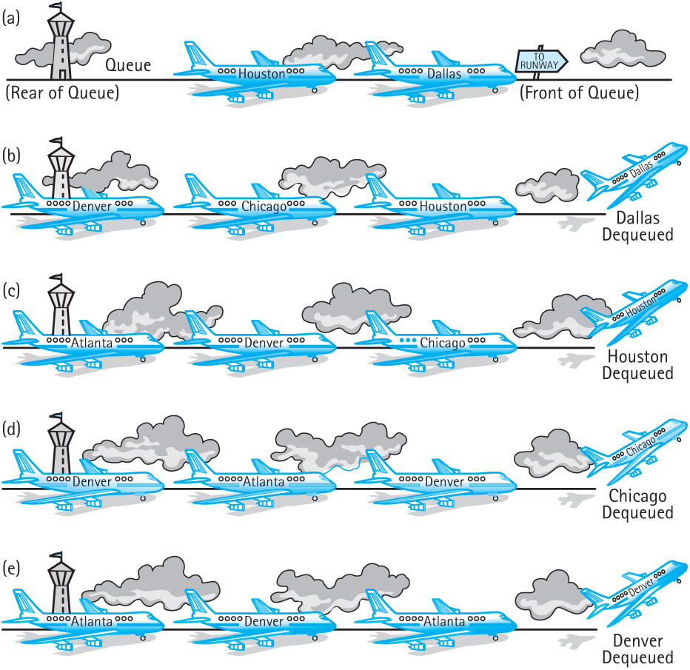
BFS Example (cont.)
Figure 13.6 Using a queue to store the routes

Slide 23
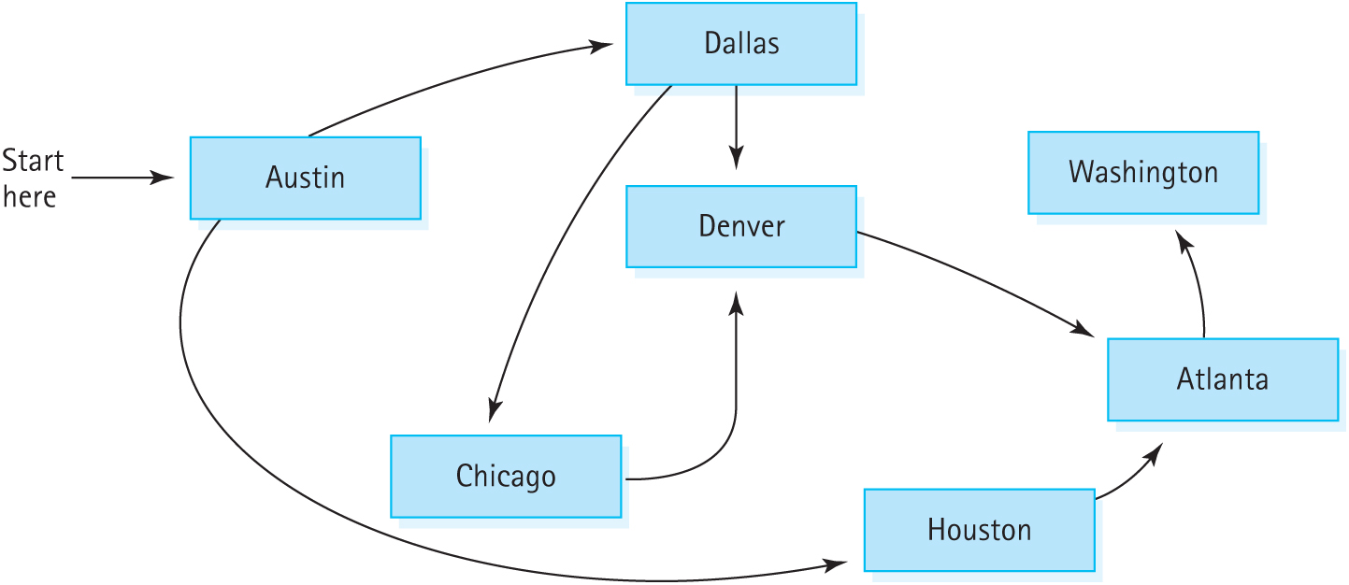
BFS Example (cont.)
Figure 13.7 The breadth-first search

Slide 24
Marking and BFS
A node adjacent to multiple nodes may be added to the queue twice
Denver is enqueued by Dallas and Chicago
If nodes are marked when they’re dequeued, a node may be enqueued multiple times
Marking a node when it is enqueued prevents multiple copies in the queue
http://www.geeksforgeeks.org/breadth-first-traversal-for-a-graph/

